Slide 1


SOLIDARITY PROJECTS
Volunteering Teams in High Priority Areas
20/09/2021 to 19/10/2021
Kavala, Greece

Slide 2
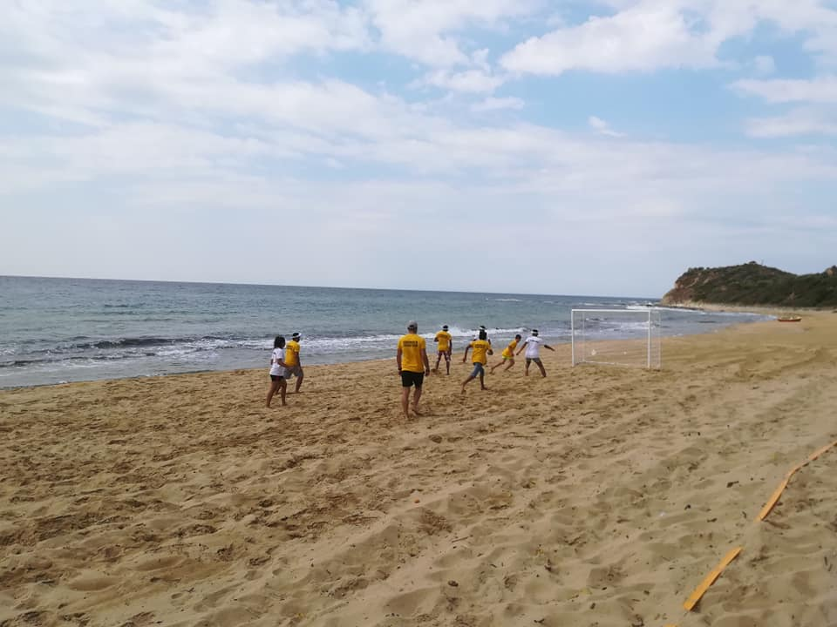
DESCRIPTION OF THE PROJECT
CULTURE
ATHLETIC FESTIVAL: The Athletic Festival is a Multi Sports event including Sports and Games next to the sea. Sports like Football, Volleyball and Catchball. Games like treasure hunting, rock painting, tag-of-war, water relay.

Slide 3

DESCRIPTION OF THE PROJECT
SURPRISE!!!
WATER RELAY: The Water Relay is an activity that will be implemented at the end of September 2021. Sand Games for social inclusion is the most important event for the local community as we will have and the Guinness Record for the first time.

Slide 4
AIM
Conduct solidarity activities which support the European Added Values
Eliminate discrimination and social exclusion of young people and aid them socialize and acquire useful tools for their lives
Raising awareness of the value of volunteering for young people and for the community as well.
OBJECTIVES
Impact on the communication skills and the language literacy of the participants
To give volunteers the opportunity to engage in a non-formal and informal learning
Enable young people to acquire useful experience, their employability and active citizenship

Slide 5
ACTIVITY AND RECOGNITION
The activity will follow the method of non-formal education and will be mostly experiential (field trips, workshops, games etc.).
Also within the frame of recognition of non-formal learning, Youthpass Certificates proving the acquired competences will be issued during the Youthpass Ceremony.

Slide 6
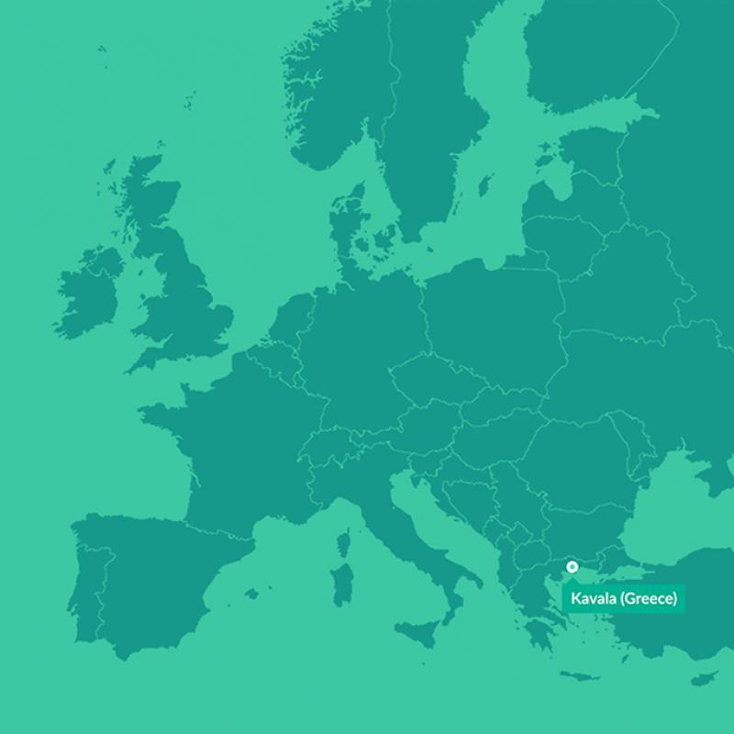
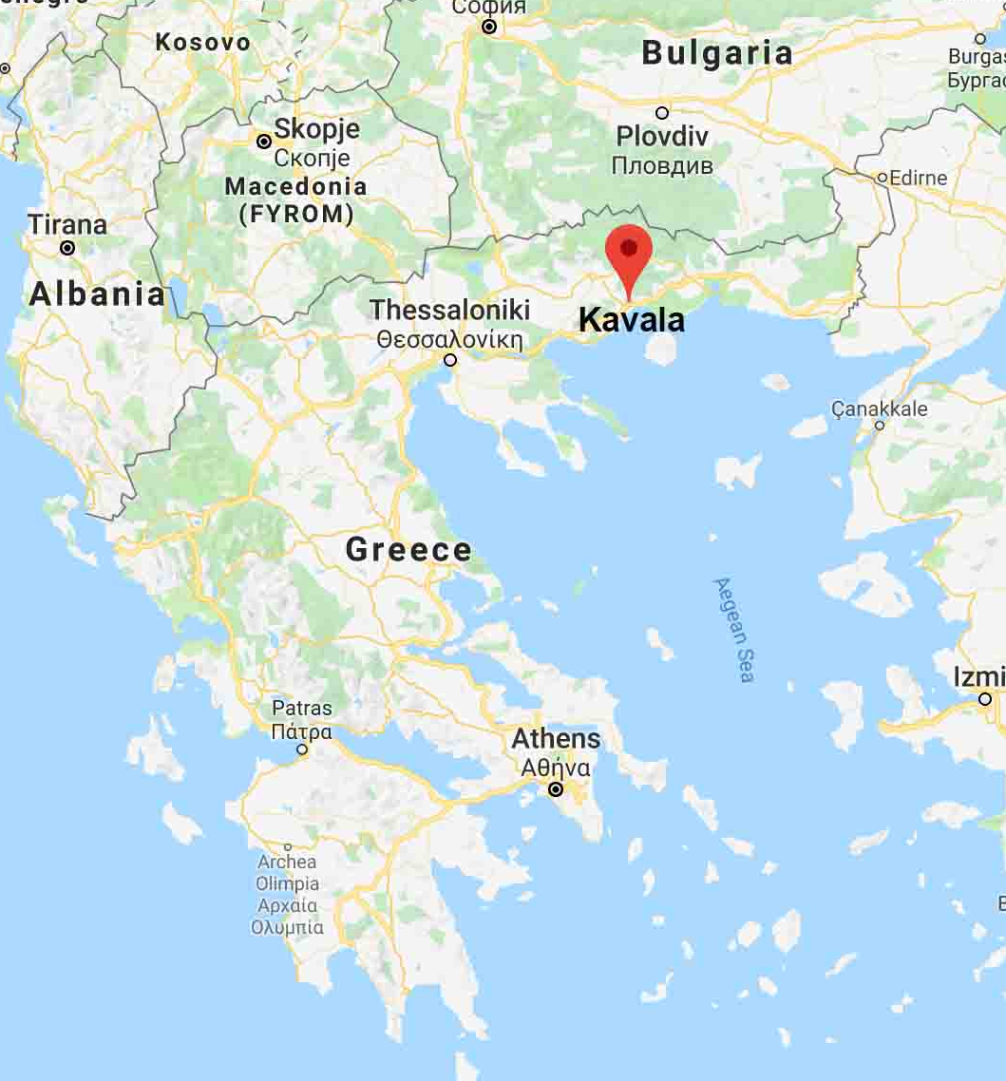
LOCATION
The project will be held in the area of Kavala, in northern Greece

Slide 7
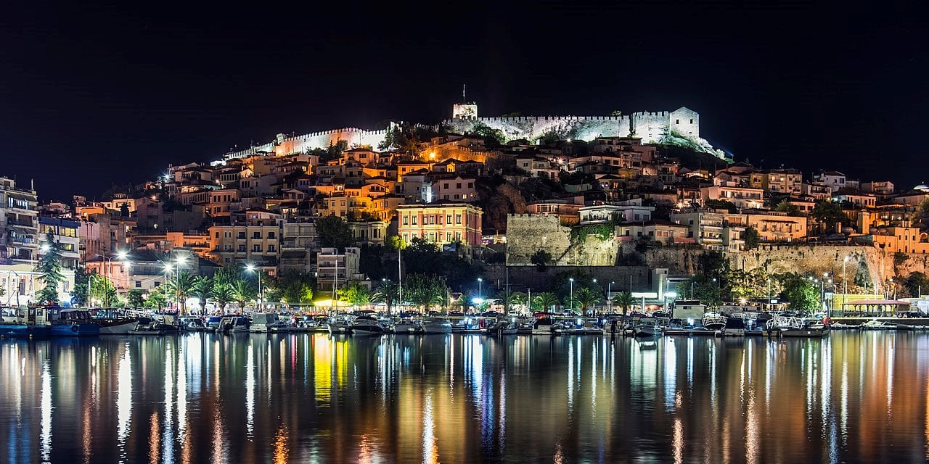
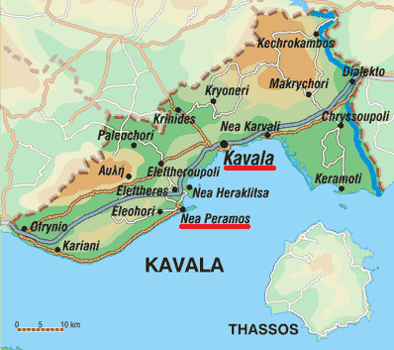
Kavala had been one of the most significant cities of Northern Greece since antiquity, with rich history and important economic activity. In the 19th century it became an urban and commercial center of tobacco production that witnessed the rise of aristocratic families, large factories, significant trade union action as well as the greatest workers' strike in the Balkans. Today, Kavala is a modern city where the memories of the past living together with the images of now. The heavy step of time, however, can still be heard in the picturesque Old Town, the medieval castle, the imposing aqueduct, the historical Ottoman buildings, the picturesque churches, the stone cobbled alleys. Add to the above the unique nature surrounding the city, its quality tourist infrastructure and its crystal clear beaches and you will understand why some call Kavala “Little Monte Carlo”!

Slide 8
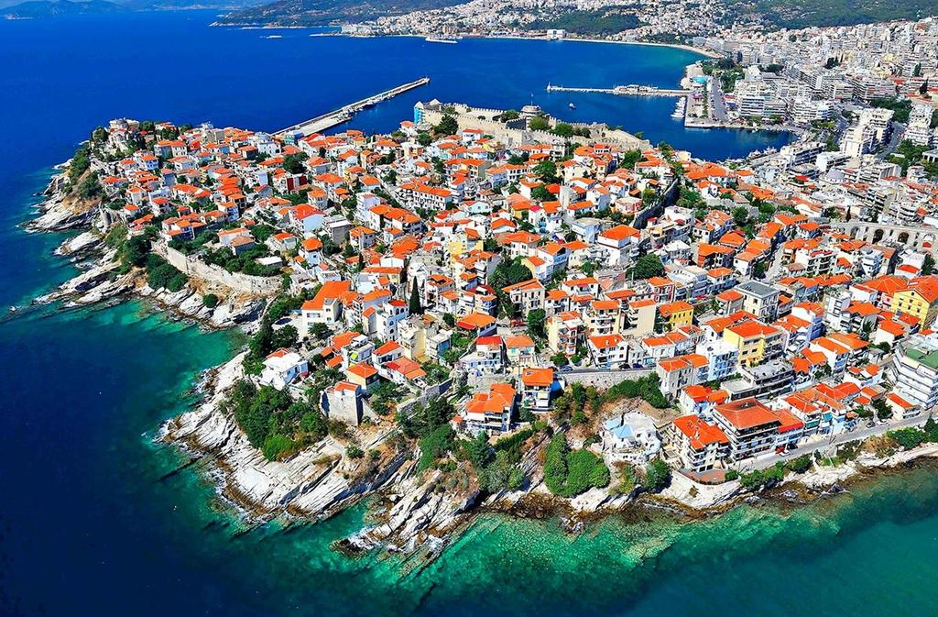
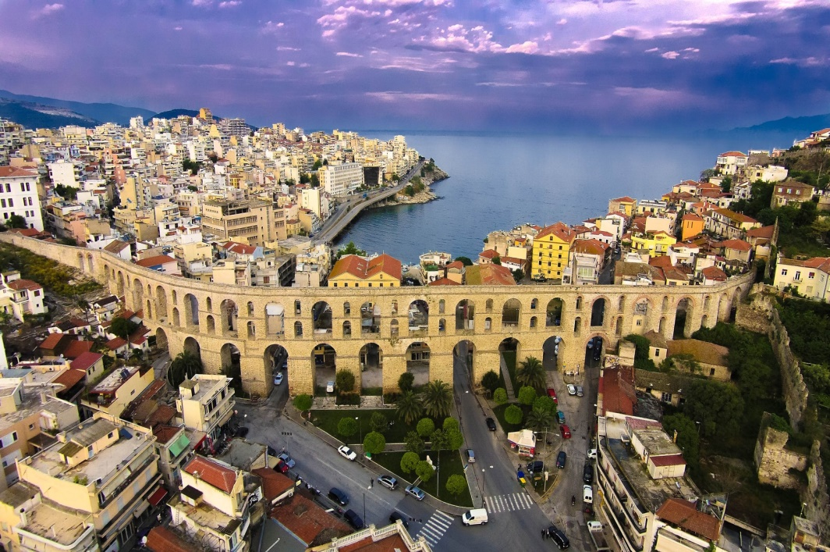
Kavala has a hot-summer Mediterranean climate. Snowfalls are sporadic and only in winter moths, but happen more or less every year. The humidity is always very high.
Traditional local recipes is based on fresh fish and sea food, salted food, mackerel "gouna" (sun dried mackerel on the grill). The meat, offered in the villages which are scattered on the massifs of Lekani and Paggaio are delicious. The grapes, wine and tsipouro produced in the area, as well as the kourabiedes (sugar-coated almond biscuits) from Nea Karvali are particularly famous.

Slide 9
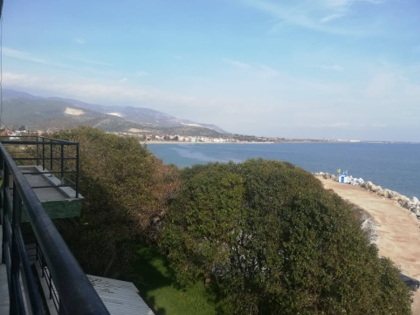
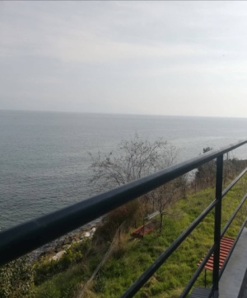
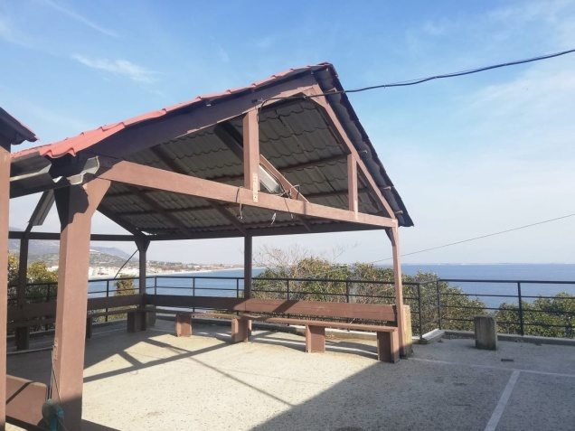
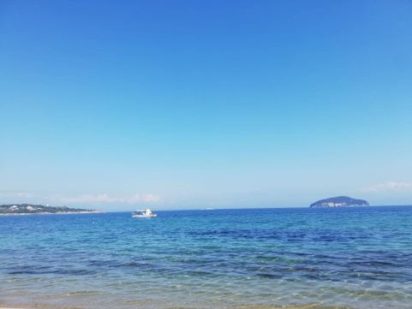
ACCOMMODATION & FOOD
You will stay in a camp, near to the city of Kavala. The accommodation is mixed bedrooms. It is a big place next to the beach.

Slide 10
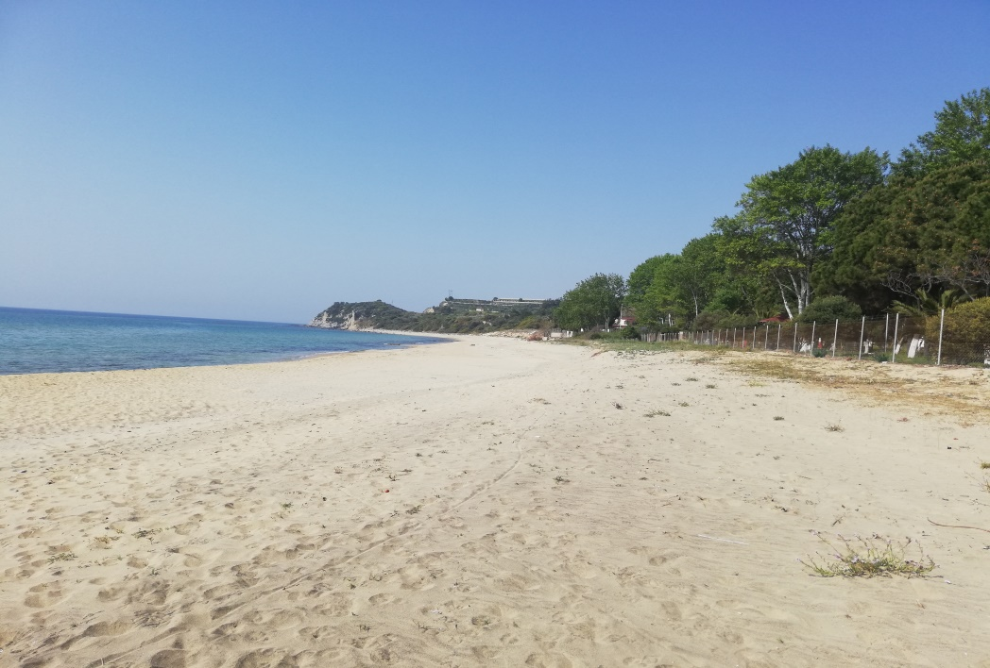
The beach is next to the camp and there is plenty time to enjoy it.
A catering will provide us the daily meals (breakfast, lunch, dinner)
There will be fruits available as snacks between the meals
You can also find several markets within a short distance

Slide 11
SPECIAL NEEDS/ALLERGIES ETC
In case any of the participants has any
special needs
health problem
allergies or
follows a certain diet
please inform us beforehand!

Slide 12
RULES
We find it important to establish and follow some certain rules, in order to make this Youth Exchange a great experience for everyone. So please:
Make sure to be punctual and follow the everyday timetable of activities
Participate in all the activities and cooperate with others
Respect the rest hours and other participants
Keep the rooms and common rooms and areas clean
More rules will be established on the first day of the project

Slide 13
WHAT TO BRING WITH YOU
Personal clothing and hygienic belongings : comfortable and athletic clothes, a towel, a light jacket and a pair of long pants.
Personal medication (we will have a first-aid kit available)
Mosquito repellent
Some spending money
Health insurance!!! (European Health Card )
Athletic or hiking shoes!
Hat and sunscreen!
(for protection from the bright Greek sun)
But we need all your energy, desire to learn and have fun to live an unrepeatable experience!!

Slide 14
HOW TO GET TO KAVALA
By Plane: you can come to the airport of Kavala, which is the nearest, or the airport of Thessaloniki, which is only 2 hours away from Kavala. From the airport of Thessaloniki you will have to take the city bus X1,N1 or N1A to go to the Central Bus Station “KTEL Makedonia” (it is the last stop). From there, you will have to take the bus to Kavala. We will pick you up from Kavala and take you to the camp, where the program will be held.
You can check the city bus route and timetable from the airport to the Central Bus Station of Thessaloniki here:
  http://oasth.gr/#en/routeinfo/list/61/12/73/
You can check the bus route and timetable from Thessaloniki to Kavala on the following site:
  https://ktelmacedonia.gr/en/routes/tid=17
*A few more solutions are the airport of Athens, Greece or the airport of Sofia, Bulgaria. In case any of these airports serve you better, don’t hesitate to ask us for more information.

Slide 15
TRAVEL COSTS AND OVERALL BUDGET
Food, accommodation and local transports for the activities will be fully covered by the project. Travel costs will be reimbursed with an amount according to the travel distance.
There is no participation fee!!!
Please note
DO NOT PURCHASE ANY TICKETS WITHOUT RECEIVING AN OFFICIAL CONFIRMATION BY EMAIL SENT BY US.

Slide 16
TRAVEL REIMBURSEMENTS
FRANCE 275€ per participant
SPAIN 360€ per participant
ROMANIA 180€ per participant
ITALY 275€ per participant

Slide 17

STAY CONNECTED
Contact Information
+34675398876 / Sara (Spanish)
sarapythia@gmail.com
+306946650559 / Ioanna (English)
evs-pythia@pythia.edu.gr
+306943074086 / Chara (French)
erasmus@pythia.edu.gr
+302592112301
(Administration Office)
(HOURS/10:00-14:00)

Slide 18





FOLLOW US
: https://www.facebook.com/Pythia.koinsep/
: https://www.instagram.com/Pythiakoinsep/
: https://twitter.com/PythiaKoinsep
: Pythia.Education.Centre
: https://vm.tiktok.com/ZMJT9jpyE/

